Slide 1
Setup: CGK Embedding

Slide 2

1 0 1 0 1 1 1 1 0 1 1 0 0 1 0 0 0 0
$$n$$

Slide 3
Time 1:
1 0 1 0 1 1 1 1 0 1 1 0 0 1 0 0 0 0
$$n$$

Slide 4
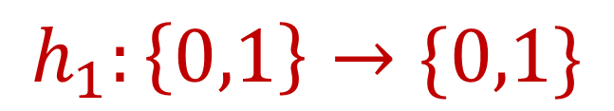
Time 1:
1 0 1 0 1 1 1 1 0 1 1 0 0 1 0 0 0 0
$$n$$
$$h_{1}:\left\{0,1\right\}→\{0,1\}$$

Slide 5


Time 1:
1 0 1 0 1 1 1 1 0 1 1 0 0 1 0 0 0 0
$$n$$
$$h_{1}:\left\{0,1\right\}→\{0,1\}$$
$$h_{1}\left(0\right)=1$$
$$h_{1}\left(1\right)=1$$

Slide 6
Time 1:
1 0 1 0 1 1 1 1 0 1 1 0 0 1 0 0 0 0
$$n$$
$$h_{1}:\left\{0,1\right\}→\{0,1\}$$
$$h_{1}\left(0\right)=1$$
$$h_{1}\left(1\right)=1$$

Slide 7
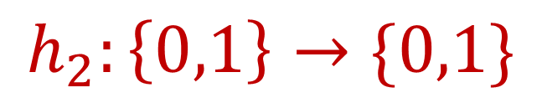


Time 2:
1 0 1 0 1 1 1 1 0 1 1 0 0 1 0 0 0 0
$$n$$
$$h_{2}:\left\{0,1\right\}→\{0,1\}$$
$$h_{2}\left(0\right)=0$$
$$h_{2}\left(1\right)=1$$

Slide 8
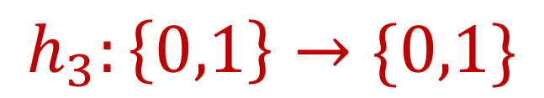


Time 3:
1 0 1 0 1 1 1 1 0 1 1 0 0 1 0 0 0 0
$$n$$
$$h_{3}:\left\{0,1\right\}→\{0,1\}$$
$$h_{3}\left(0\right)=0$$
$$h_{3}\left(1\right)=0$$

Slide 9
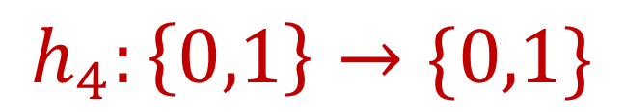


Time 4:
1 0 1 0 1 1 1 1 0 1 1 0 0 1 0 0 0 0
$$n$$
$$h_{4}:\left\{0,1\right\}→\{0,1\}$$
$$h_{4}\left(0\right)=1$$
$$h_{4}\left(1\right)=0$$

Slide 10
Time 4:
1 0 1 0 1 1 1 1 0 1 1 0 0 1 0 0 0 0
$$n$$
$$h_{4}:\left\{0,1\right\}→\{0,1\}$$
$$h_{4}\left(0\right)=1$$
$$h_{4}\left(1\right)=0$$

Slide 11
Time 5:
1 0 1 0 1 1 1 1 0 1 1 0 0 1 0 0 0 0
$$n$$

Slide 12



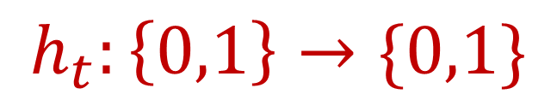
Time $t$:
1 0 1 0 1 1 1 1 0 1 1 0 0 1 0 0 0 0
$$n$$
$$h_{t}:\left\{0,1\right\}→\{0,1\}$$
$$h_{t}\left(0\right)=1$$
$$h_{t}\left(1\right)=0$$

Slide 13
Problem: Cyclic Hash Functions

Slide 14

1 0 1 0 1 1 1 1 0 1 1 0 0 1 0 0 0 0
$$n$$
$$h_{1},…,h_{r}:\left\{0,1\right\}→\{0,1\}$$

Slide 15
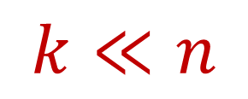
1 0 1 0 1 1 1 1 0 1 1 0 0 1 0 0 0 0
$$n$$
$$k≪n$$

Slide 16

1 0 1 0 1 1 1 1 0 1 1 0 0 1 0 0 0 0
$$n$$
$$k≪n$$

Slide 17


Time $t$:
1 0 1 0 1 1 1 1 0 1 1 0 0 1 0 0 0 0
$$n$$
$$h_{t \left(mod r\right)}:\left\{0,1\right\}→\{0,1\}$$
$$r\sim poly(k,\log{n)}$$

Slide 18
Time $t$:
1 0 1 0 1 1 1 1 0 1 1 0 0 1 0 0 0 0
$$n$$
$$h_{t \left(mod r\right)}:\left\{0,1\right\}→\{0,1\}$$
$$r\sim poly(k,\log{n)}$$

Slide 19

Time $t$:
1 0 1 0 1 1 1 1 0 1 1 0 0 1 0 0 0 0
$$n$$
$$h_{t \left(mod r\right)}:\left\{0,1\right\}→\{0,1\}$$
$$r\sim poly(k,\log{n)}$$
Can we lower bound the probability that we use different hash functions for each of the $k$ positions by $1/poly(k,\log{n)}$?

Slide 20
Application: Streaming Algorithms with Edit Distance

Slide 21

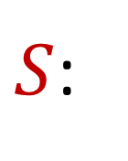

$S$:
1 0 1 0 1 1 1 1 0 1 1 0 0 1 0 0 0 0
$T$:
1 0 1 0 1 1 0 1 0 1 1 1 0 1 0 0 0 0
$$HAM\left(S,T\right)=2$$

Slide 22


$S$:
0 1 0 1 0 1 1 0 1 0 1 1 1 0 1 0 0 0
$T$:
1 0 1 0 1 1 0 1 0 1 1 1 0 1 0 0 0 1
$$ed\left(S,T\right)=2$$
$$HAM\left(S,T\right)=13$$

Slide 23
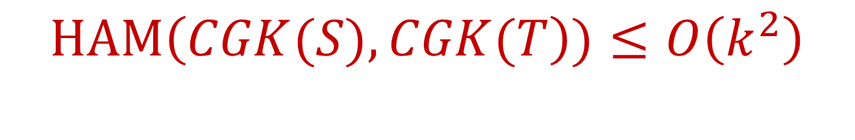

$$ed\left(S,T\right)≤k$$
$$HAM\left(CGK(S),CGK(T\right))≤O\left(k^{2}\right)$$

Slide 24
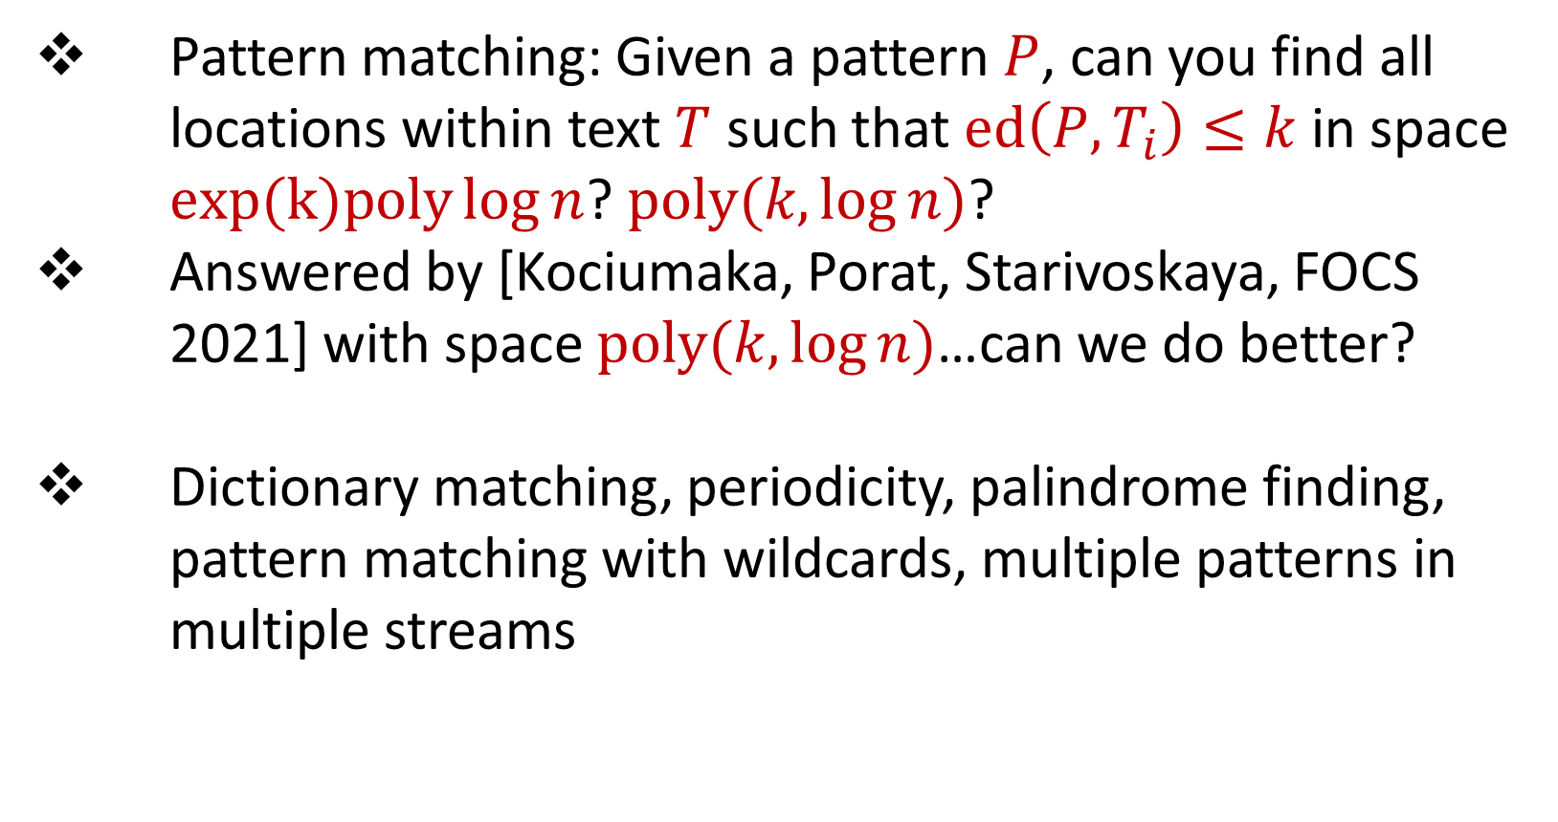
Pattern matching: Given a pattern $P$, can you find all locations within text $T$ such that $ed\left(P,T_{i}\right)≤k$ in space $exp(k)poly\log{n}$? $poly(k,\log{n)}$?
Answered by [Kociumaka, Porat, Starivoskaya, FOCS 2021] with space $poly(k,\log{n)}$…can we do better?
Dictionary matching, periodicity, palindrome finding, pattern matching with wildcards, multiple patterns in multiple streams

